Slide 1
God’s Plan of Salvation
Explained using scriptures from the book of Romans, collectively known as:
The Roman Road.
The book of Romans, part of the Bible, was written by the Apostle Paul in about 58AD

Slide 2
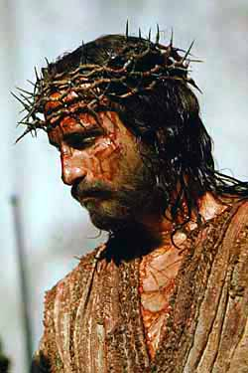
God’s Plan of Salvation
Intro
What the Bible said
700 years before Jesus:
He was pierced for our transgressions,
he was crushed for our iniquities;
the punishment that brought us peace was upon him,
and by his wounds we are healed.
The Prophet Isaiah
Chapter 53 verse 5

Slide 3
God’s Plan of Salvation
1
What the Bible says:
For all have sinned and fall short of the glory of God.
Romans. Chapter 3 verse 23
Admit that
I am a sinner
My Response?

Slide 4
God’s Plan of Salvation
2
What the Bible says:
For the wages of sin is death, but the gift of God is eternal life in Christ Jesus.
Romans. Chapter 6 verse 23
Accept that sin
leads to death
My Response?

Slide 5
God’s Plan of Salvation
3
What the Bible says:
God demonstrates His own love for us in this: while we were yet sinners Christ died for us.
Romans. Chapter 5 verse 8
Realise that Jesus
died for my sin
My Response?

Slide 6
God’s Plan of Salvation
4
What the Bible says:
Everyone who calls on the name of the Lord will be saved.
Romans. Chapter 10 verse 13
Repent from sin
and trust in Jesus
My Response?

Slide 7
God’s Plan of Salvation
5
What the Bible says:
That if you confess with your mouth, "Jesus is Lord," and believe in your heart that God raised him from the dead, you will be saved.
Romans. Chapter 10 verse 9
Believe in him and
be forgiven
My Response?

Slide 8
God’s Plan of Salvation
6
What the Bible says:
For God so loved the world that he gave his one and only Son, that whoever believes in him shall not perish but have eternal life.
The Gospel of John.
Chapter 3 verse 16

Slide 9
God’s Plan of Salvation
End
Father in Heaven, I know that I am a sinner and need forgiveness. I believe that Your Son Jesus died in my place, to pay the penalty for my sin, and rose again for my salvation. I want to turn from my sinful ways, so I now ask you, Lord Jesus, to come into my life as my Saviour and my Lord. In Jesus name I pray, Amen.
My Response?

